Slide 1
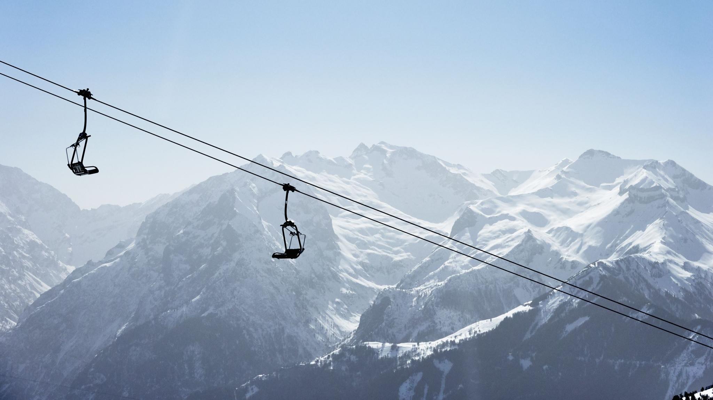
Big Mountain Resort
Pricing Recommendation

Slide 2
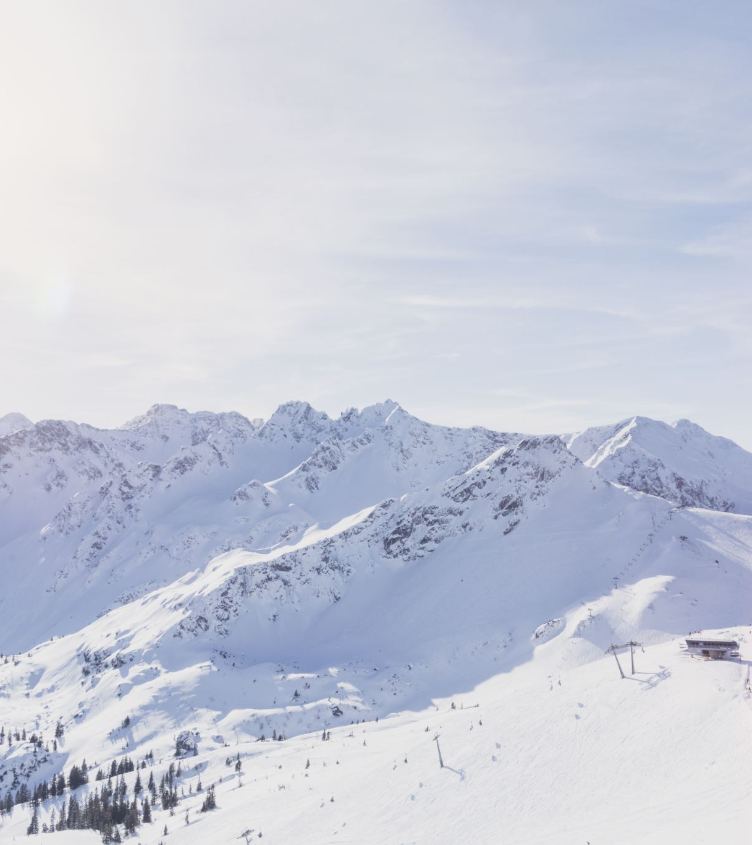
The Problem
What opportunities exist for Big Mountain Resort to reduce costs or increase revenue by an amount equal to or greater than the added operating costs of an additional chair lift?
The additional chair lift increases operating costs by $1,540,000 this season.
The resort was also curious if a better pricing strategy existed, one that gives the company a clear sense of what facilities are more important than others.

Slide 3
Recommendation
The mean absolute error for the market from our model was about $10.39. The model was then fit on data for Big Mountain Resort exclusively. The modeled price for the company was $95.87, but the actual price is $81.00.
Scenario 2 increases the vertical drop by adding a run to a point 150 feet lower down but requires the installation of an additional chair lift to bring skiers back up, without additional snow making coverage.
This scenario increases support for ticket price by $1.99. Over the season, this could be expected to amount to $3,474,638.00.

Slide 4

Modeling pt. 1
We loaded in a CSV file containing data for various features of multiple resorts in the market, including Big Mountain Resort.
Special notice was given to columns containing ticket prices.
Some resorts were removed from the dataset completely for not possessing any ticket price information.
It was determined that the target feature when modeling ticket price would be weekend ticket prices, so weekday prices were dropped all together.

Slide 5
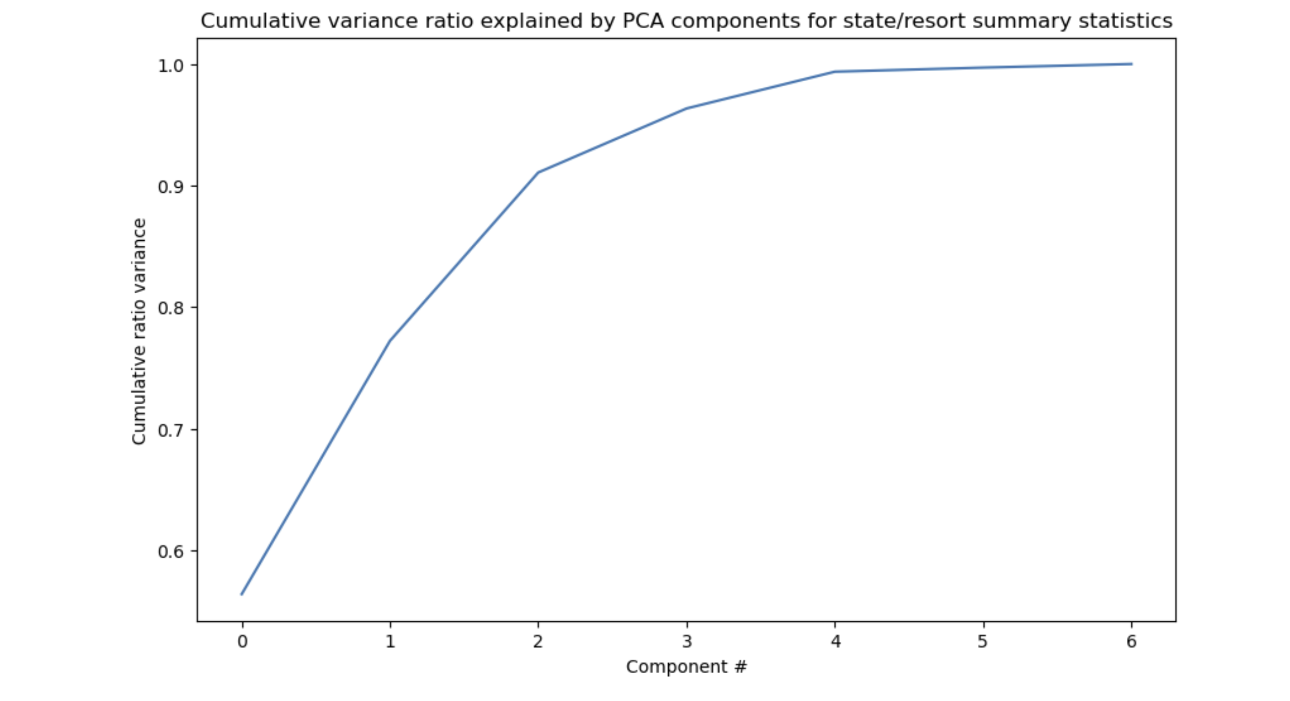
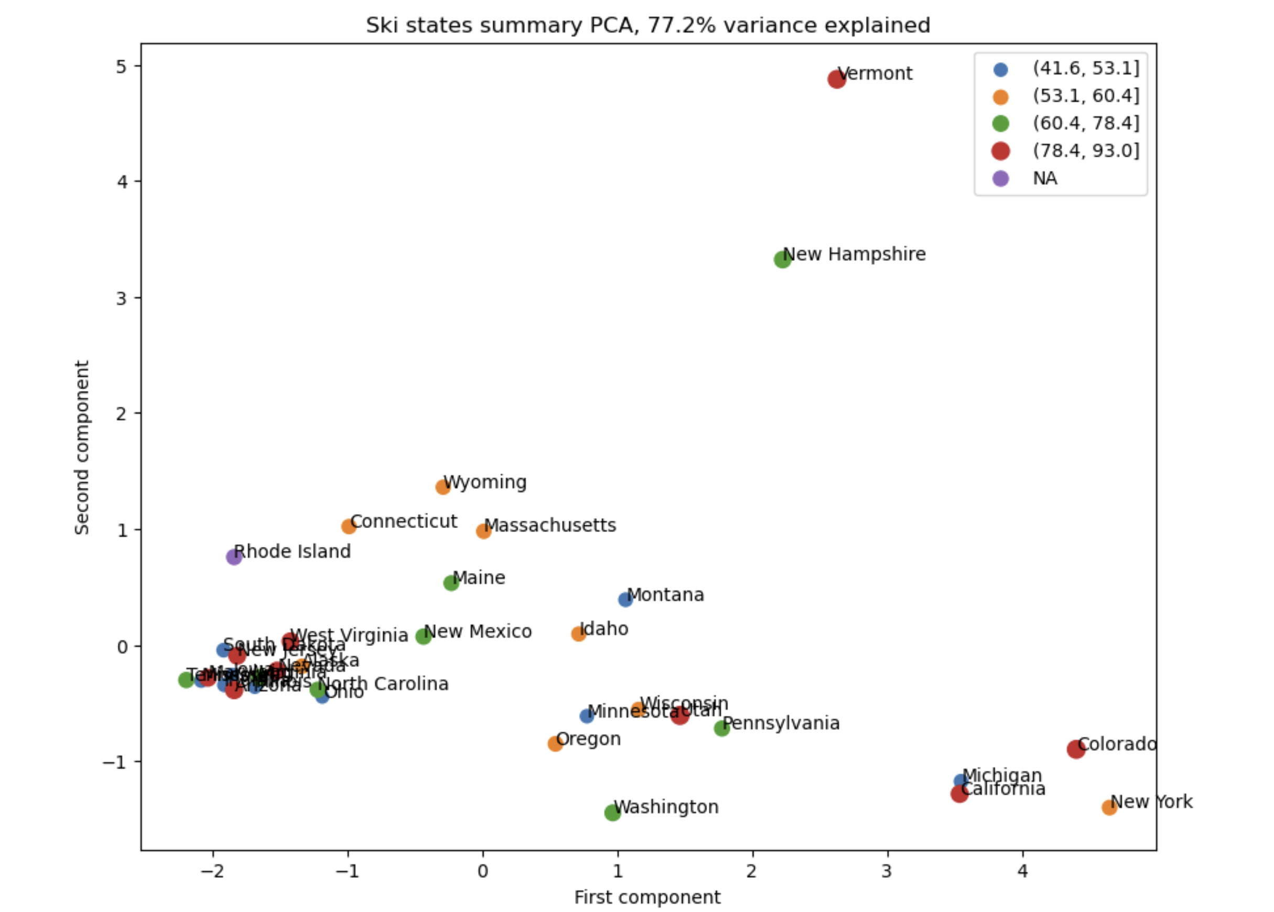
Modeling pt. 2
We used principal component analysis (PCA) during EDA to find how much of the variance in the data could be explained across different components for each state in the market.
The first two components accounted for over 75% of the variance (Figure 1).
We subset by these two components and used a scatterplot as a visualization. This visualization did not yield any conclusive results (Figure 2).
Figure 1
Figure 2

Slide 6
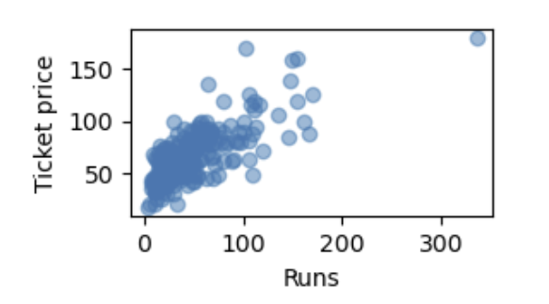
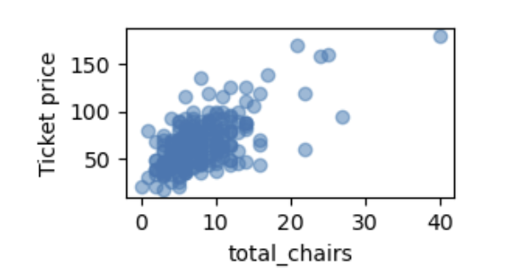
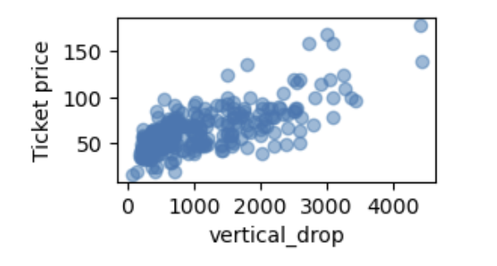
Modeling pt. 3
A heatmap was created to identify correlation between the variables.
Scatterplots were also utilized to get a better idea of correlation between variables and ticket price specifically.
The features vertical_drop, Runs, and total_chairs displayed strong, positive correlations.

Slide 7
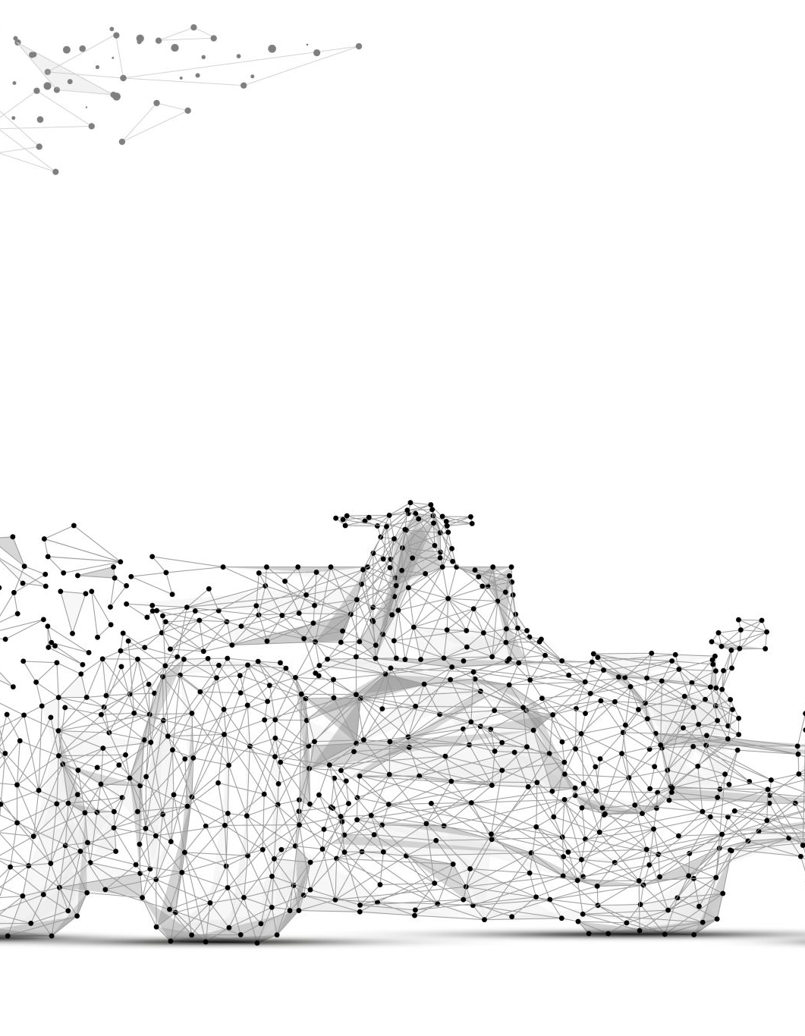
Modeling pt. 4
We initialized a 70/30 train/test split needed to evaluate a model's performance.
We created an initial model that used median imputation.
The data was then scaled, and linear regression was applied to predict y_train and y_test values.
The model's performance was assessed by R-squared, Mean Absolute Error, and Mean Squared Error metrics.
We refined our initial model by utilizing cross-validation and determining what is the best k best features to use (which was 8).
The same process was repeated using a random forest model. The same top features present in our linear model were present in the random forest model.
With a mean absolute error of roughly 9.54, the random forest regression model was deemed better than the linear regression model which had a mean absolute error around 11.79.

Slide 8

Conclusion
Big Mountain Resort ranked highly across many features, but their current price does not match the modeled price.
The business could make use of the given model by adjusting price slightly and then modifying their resort data within the model to gain even further insights.
The model can also be used when brainstorming other scenarios and trying to determine whether the scenario supports an increase or decrease in ticket price.
This model is saved and is readily available for others to use.

